Slide 1
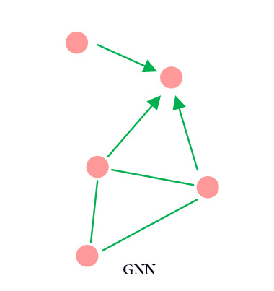
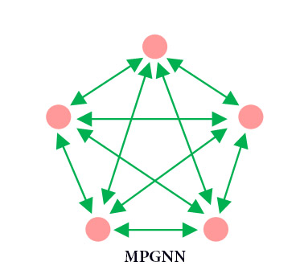
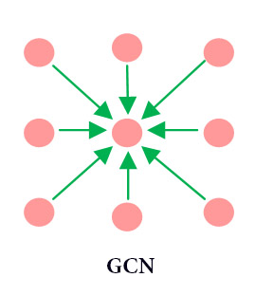

Slide 2
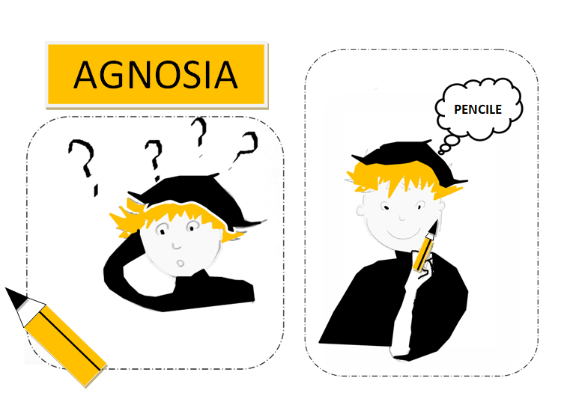
damage to the posterior parietal cortex
Spatial concept examined in SpatialSim
benchmark

Slide 3
2021 research goals
1. spatial reasoning / GNN, MPGNN,GCN
2. GANs and robot
3. Transformer
4. NLP / interaction

